Slide 1
Object-Oriented Systems Development:
Using the Unified Modeling Language
Chapter 6:
Object-Oriented Analysis Process: Identifying Use Cases
Object-Oriented Systems Development Bahrami © Irwin/ McGraw-Hill

Slide 2

Goals
The use-case approach to object-oriented analysis and the object-oriented analysis process.
Identifying actors.
Identifying use cases.
Documentation.
Object-Oriented Systems Development Bahrami © Irwin/ McGraw-Hill

Slide 3

... just think of all the Christmas presents that are never removed from their boxes before being returned.
Weinberg and Gause
Object-Oriented Systems Development Bahrami © Irwin/ McGraw-Hill

Slide 4
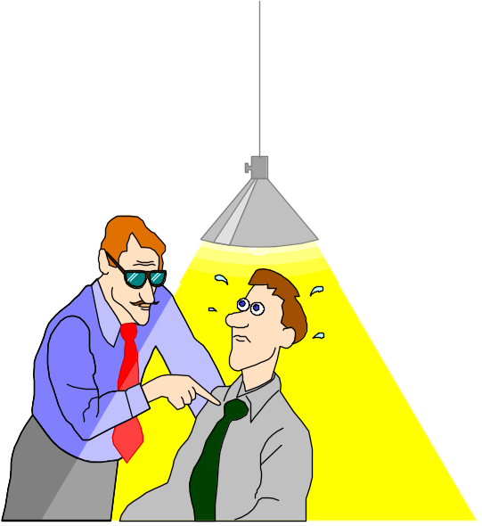
What Is Analysis?
Analysis is the process of transforming a problem definition from a fuzzy set of facts and myths into a coherent statement of a system’s requirements.
Object-Oriented Systems Development Bahrami © Irwin/ McGraw-Hill

Slide 5
Analysis
The main objective of the analysis is to capture:
  a complete, unambiguous, and consistent picture of the requirements of the system and
  what the system must do to satisfy the users' requirements and needs.
Object-Oriented Systems Development Bahrami © Irwin/ McGraw-Hill

Slide 6

Where Should We Start?
1. Examination of existing system documentation.
2. Interviews.
3. Questionnaire.
4. Observation.
Object-Oriented Systems Development Bahrami © Irwin/ McGraw-Hill

Slide 7

Requirements Difficulties
Three most common sources of requirements difficulties are:
1. Incomplete requirements.
2. Fuzzy descriptions (such as fast response).
3. Unneeded features.
Object-Oriented Systems Development Bahrami © Irwin/ McGraw-Hill

Slide 8

The Object-Oriented Analysis (OOA) Process
The process consists of the following steps:
1. Identify the actors:
  Who is using the system?
  Or, in the case of a new system, who will be using the system?
Object-Oriented Systems Development Bahrami © Irwin/ McGraw-Hill

Slide 9
The OOA Process (Con’t)
2. Develop a simple business process model using UML activity diagram.
Object-Oriented Systems Development Bahrami © Irwin/ McGraw-Hill

Slide 10
The OOA Process (Con’t)
3. Develop the use case:
  What the users are doing with the system?
  Or, in the case of a new system, what users will be doing with the system?
Use cases provide us with comprehensive
documentation of the system under study.
Object-Oriented Systems Development Bahrami © Irwin/ McGraw-Hill

Slide 11
The OOA Process (Con’t)
4. Prepare interaction diagrams:
  Determine the sequence.
  Develop collaboration diagrams.
Object-Oriented Systems Development Bahrami © Irwin/ McGraw-Hill

Slide 12
The OOA Process (Con’t)
5. Classification—develop a static UML class diagram:
  Identify classes.
  Identify relationships.
  Identify attributes.
  Identify methods.
Object-Oriented Systems Development Bahrami © Irwin/ McGraw-Hill

Slide 13
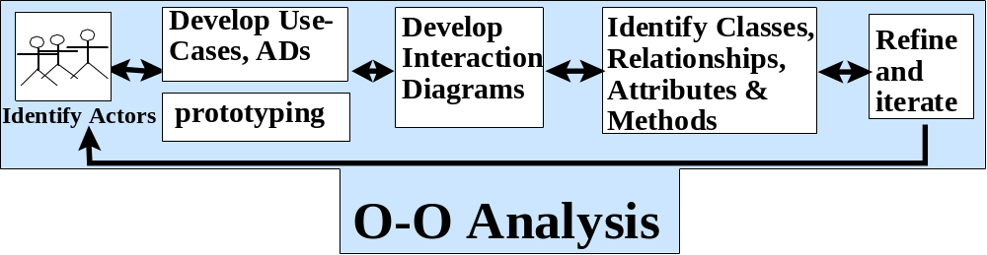
The OOA Process (Con’t)
6. Iterate and refine: If needed, repeat the preceding steps.
Object-Oriented Systems Development Bahrami © Irwin/ McGraw-Hill

Slide 14
Developing Business Processes
Developing an activity diagram of the business processes can provide us with an overall view of the system.
Object-Oriented Systems Development Bahrami © Irwin/ McGraw-Hill
Notes:
Business process modeling can be very time consuming, so the main idea should be to get a basic model without spending too much time on the process. The advantage of developing a business process model is that it makes you more familiar the system and therefore the user requirements and also aids in developing use cases.

Slide 15
Use Case Model
Use cases are scenarios for understanding system requirements.
The use-case model describes the uses of the system and shows the courses of events that can be performed.
Object-Oriented Systems Development Bahrami © Irwin/ McGraw-Hill

Slide 16
Use Case Model (Con’t)
Use case defines what happens in the system when a use case is performed.
The use-case model tries to systematically identify uses of the system and therefore the system's responsibilities.
Object-Oriented Systems Development Bahrami © Irwin/ McGraw-Hill

Slide 17
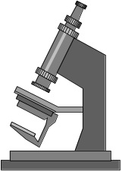

Use Cases Under the Microscope
"A Use Case is a sequence of transactions in a system whose task is to yield results of measurable value to an individual actor of the system."
What is a
Use Case
again?
Object-Oriented Systems Development Bahrami © Irwin/ McGraw-Hill

Slide 18
Use Case Key Concepts
Use case. Use case is a special flow of events through the system.
Actors. An actor is a user playing a role with respect to the system.
In a system. This simply means that the actors communicate with the system's use case.
Object-Oriented Systems Development Bahrami © Irwin/ McGraw-Hill
Notes:
Remember, when dealing with actors, it is important to think about roles rather than just people and their job titles.

Slide 19
Use Case Key Concepts (Con’t)
A measurable value. A use case must help the actor to perform a task that has some identifiable value.
Transaction. A transaction is an atomic set of activities that are performed either fully or not at all.
Object-Oriented Systems Development Bahrami © Irwin/ McGraw-Hill

Slide 20
Use Associations
The use association occurs when you are describing your use cases and notice that some of them have common subflows.
The use association allows you to extract the common subflow and make it a use case of its own.
Object-Oriented Systems Development Bahrami © Irwin/ McGraw-Hill
Notes:
A use-case description can be difficult to understand if it contains too many alternatives or exceptional flows of events that are performed only if certain conditions are met as the use-case instance is carried out. A way to simplify the description is to take advantage of extends and uses associations. The extends and uses associations often are sources of confusion, so let us take look at these relationships.

Slide 21
Extends Associations
The extends association is used when you have one use case that is similar to another use case but does a bit more or
Is more specialized; in essence, it is like a subclass.
Object-Oriented Systems Development Bahrami © Irwin/ McGraw-Hill

Slide 22
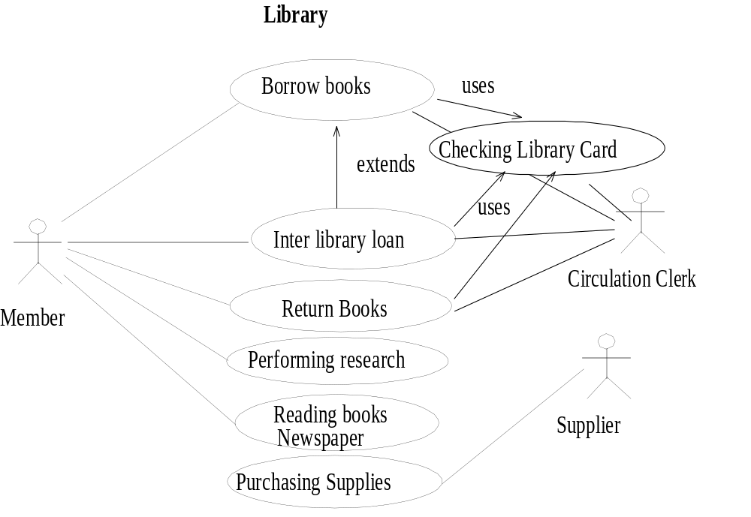
Object-Oriented Systems Development Bahrami © Irwin/ McGraw-Hill
Notes:
The similarity between extends and uses associations is that both can be viewed as a kind of inheritance. When you want to share common sequences in several use cases utilize the uses association by extracting common sequences into a new, shared use case. The extends association is found when you add a bit more specialized, new use case that extends some of use cases that you have.

Slide 23
Types of Use Cases
Use cases could be viewed as concrete or abstract.
An abstract use case is not complete and has no initiation actors but is used by a concrete use case, which does interact with actors.
Object-Oriented Systems Development Bahrami © Irwin/ McGraw-Hill

Slide 24

Identifying the Actors
The term actor represents the role a user plays with respect to the system.
When dealing with actors, it is important to think about roles rather than people or job titles.
Object-Oriented Systems Development Bahrami © Irwin/ McGraw-Hill
Notes:
A user may play more than one role. For instance, a member of a public library also may play the role of volunteer at the help desk in the library.

Slide 25
Identifying the Actors (Con’t)
Candidates for actors can be found through the answers to the following questions:
  Who is using the system? Or,
  Who is affected by the system? Or,
  Which groups need help from the system to perform a task?
Object-Oriented Systems Development Bahrami © Irwin/ McGraw-Hill

Slide 26
Identifying the Actors (Con’t)
  Who affects the system? Or,
  Which user groups are needed by the system to perform its functions? These functions can be both main functions and secondary functions, such as administration.
  Which external hardware or other systems (if any) use the system to perform tasks?
Object-Oriented Systems Development Bahrami © Irwin/ McGraw-Hill

Slide 27
Identifying the Actors (Con’t)
  What problems does this application solve (that is, for whom)?
  And, finally, how do users use the system (use case)? What are they doing with the system?
Object-Oriented Systems Development Bahrami © Irwin/ McGraw-Hill

Slide 28
Guidelines for Finding Use Cases
For each actor, find the tasks and functions that the actor should be able to perform or that the system needs the actor to perform.
Name the use cases.
Describe the use cases briefly by applying terms with which the user is familiar.
Object-Oriented Systems Development Bahrami © Irwin/ McGraw-Hill

Slide 29
Separate Actors From Users
Each use case should have only one main actor.
Isolate users from actors.
Isolate actors from other actors (separate the responsibilities of each actor).
Isolate use cases that have different initiating actors and slightly different behavior.
Object-Oriented Systems Development Bahrami © Irwin/ McGraw-Hill

Slide 30

Documentation
An effective document can serve as a communication vehicle among the project's team members, or it can serve as initial understanding of the requirements.
Object-Oriented Systems Development Bahrami © Irwin/ McGraw-Hill

Slide 31
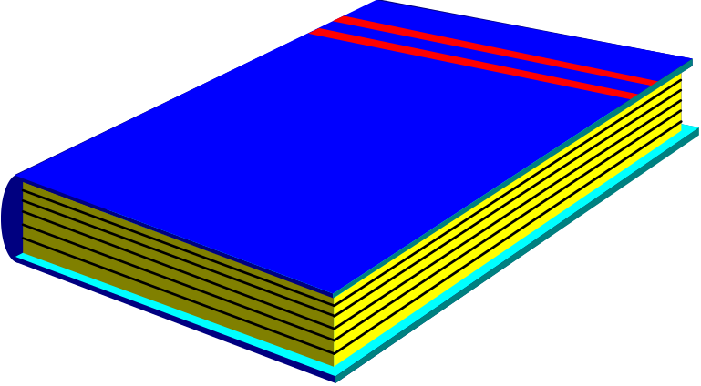
Effective Documentation: Common Cover
All documents should share a common cover sheet that identifies the document, the current version, and the individual responsible for the content.
Object-Oriented Systems Development Bahrami © Irwin/ McGraw-Hill

Slide 32
80–20 Rule
80 percent of the work can be done with 20 percent of the documentation.
The trick is to make sure that the 20 percent is easily accessible and the rest (80 percent) is available to those (few) who need to know.
80%-20%
Object-Oriented Systems Development Bahrami © Irwin/ McGraw-Hill

Slide 33

Familiar Vocabulary
Use a vocabulary that your readers understand and are comfortable with.
The main objective here is to communicate with readers and not impress them with buzz words.
Object-Oriented Systems Development Bahrami © Irwin/ McGraw-Hill

Slide 34

Make the Document as Short as Possible
Eliminate all repetition;
Present summaries, reviews, organization chapters in less than three pages;
Make chapter headings task oriented so that the table of contents also could serve as an index.
Object-Oriented Systems Development Bahrami © Irwin/ McGraw-Hill

Slide 35
Organize the Document
Use the rules of good organization (such as the organization's standards, college handbooks, Strunk and White's Elements of Style, or the University of Chicago Manual of Style) within each section.
Object-Oriented Systems Development Bahrami © Irwin/ McGraw-Hill

Slide 36

Summary
The main objective of the analysis is to capture a complete, unambiguous, and consistent picture of the requirements of the system.
Construct several models and views of the system to describe what the system does rather than how.
Object-Oriented Systems Development Bahrami © Irwin/ McGraw-Hill

Slide 37
Summary (Con’t)
Capturing use cases is one of the first things to do in coming up with requirements.
Every use case is a potential requirement.
Object-Oriented Systems Development Bahrami © Irwin/ McGraw-Hill

Slide 38
Summary (Con’t)
The key in developing effective documentation is to eliminate all repetition; present summaries, reviews, organization chapters in less than three pages.
Use the 80–20 rule: 80 percent of the work can be done with 20 percent of the documentation.
Object-Oriented Systems Development Bahrami © Irwin/ McGraw-Hill

